Slide 1









RESTAURANT MENU
MANAGEMENT SYSTEM
THE CULINARY HUB
Rohit Yadav
3D MINI PROJECT PRESENTATION
Python • Tkinter • SQLite • CSV

Slide 2








01 Project Overview
Professional presentation of the working mini project
PROJECT IDEA
A desktop application that manages restaurant menu items through a simple graphical interface.
The application combines Python GUI programming with SQLite database storage.
PROBLEM SOLVED
Manual menu records are difficult to maintain
Searching records takes time
Updates can cause errors
Data needs organized storage
This system provides a centralized solution.

Slide 3


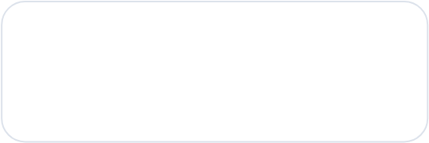
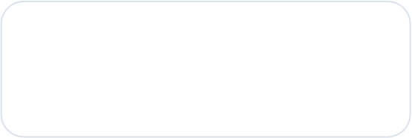






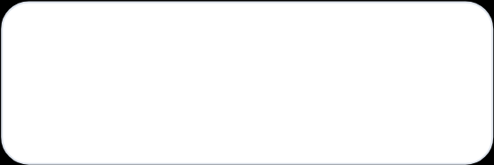
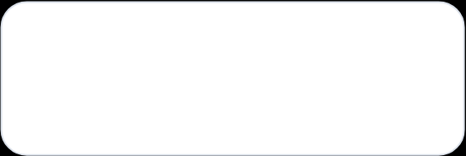




02 Objectives
Easy to Use
Simple interface for menu management.
Database
Store records permanently in SQLite.
Fast Operations
Add, update, delete and search quickly.
Export
Save menu information as CSV.

Slide 4



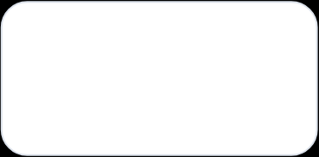
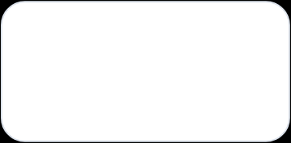
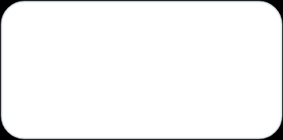









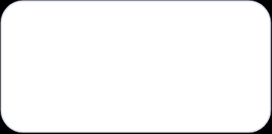
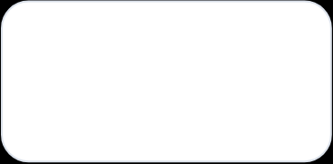
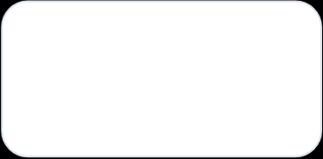






03 Technologies Used
Python
Tkinter
SQLite
Core programming
GUI development
Database
Pillow
CSV
VS Code
Logo / image support
Data export
Development environment

Slide 5
04 Key Features
Functions available in the current application
ADD
UPDATE
DELETE
New menu item
Edit record
Remove record
SEARCH
SHOW ALL
EXPORT CSV
Find item
Display records
Save records

Slide 6
05 System Workflow
From user input to database and export
STEP 1
STEP 2
STEP 3
Open Application
Enter Item Details
Add / Update / Delete
STEP 4
STEP 5
STEP 6
Store in SQLite
Search / Show All
Export CSV

Slide 7
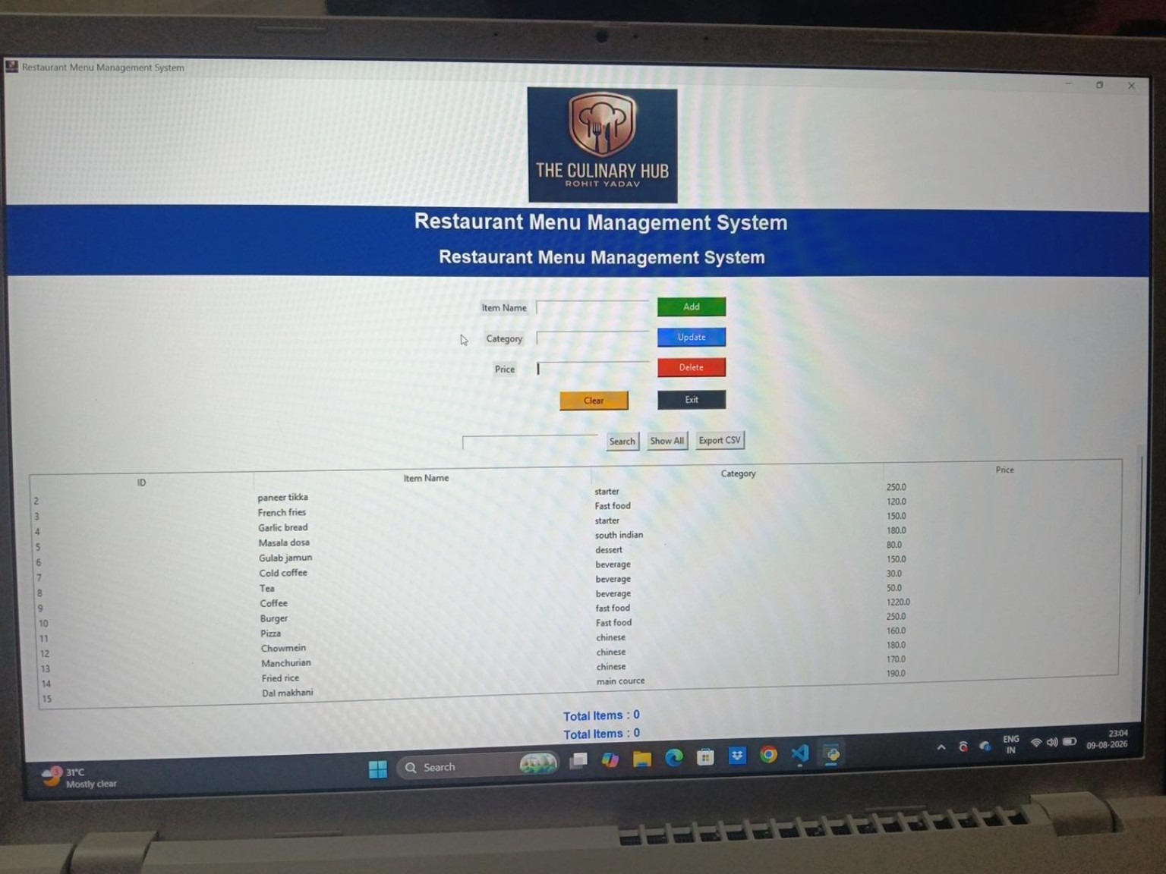


06 Project Interface
Actual working application screenshot

Slide 8








07 Database Design
SQLite database structure used by the application
DATABASE
File: restaurant.db
Table: menu
ID — Primary Key item_name — Menu item category — Food category price —Item price
DATA EXAMPLE
Paneer Tikka | Starter | ₹250 French Fries | Fast Food | ₹120 Masala Dosa | South Indian | ₹180 Cold Coffee | Beverage | ₹150
Records remain stored for future use.

Slide 9



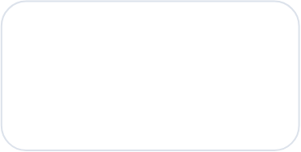
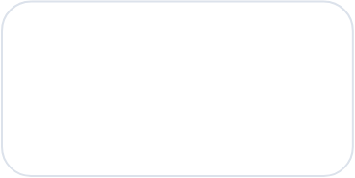
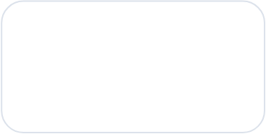









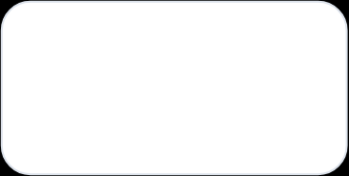
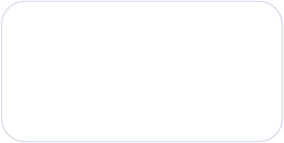
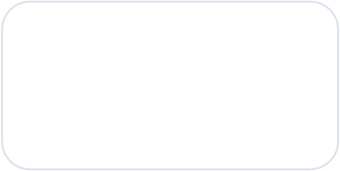






08 Live Demonstration Plan
What to demonstrate to the teacher
1. ADD 2. UPDATE
Add a newfood item Change item details
3. DELETE
Remove selected item
4. SEARCH
5. SHOWALL
6. EXPORT
Search by item name
Display complete menu
Create CSV file

Slide 10
09 Future Scope & Conclusion
FUTURE SCOPE
CONCLUSION
Login system
Correct live total counter
Billing module
Sales reports
Role-based access
Web version using Flask
The project demonstrates practical use of Python, GUI programming and da
It can be expanded into a complete restaurant management system.
THANK YOU!

